Slide 1
YOU CAN SIGN!
British Sign Language (BSL) Level 1 Classroom Presentation
Tutor: Natalie (Profoundly Deaf BSL Tutor) | Accredited by Signature BSL Level 1
You Can Sign! | British Sign Language Level 1
Slide 1

Slide 2
WEEK 1
Introduction to BSL, Alphabet and Greetings
You Can Sign! | British Sign Language Level 1
Slide 2

Slide 3
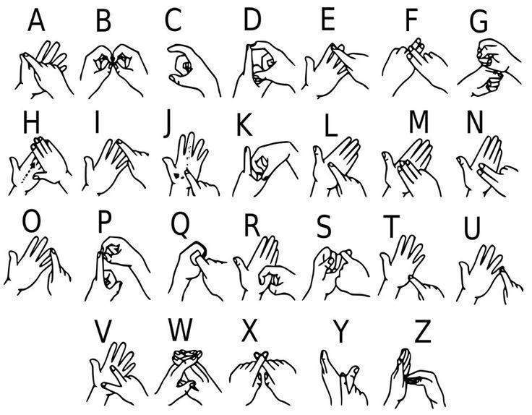
Week 1 — Lesson 1 : Alphabet and Greetings
Task : Fingerspell your first and last name
Try These:
James | Aisha | Sophia | Liam | Hiroshi | Emily | Miguel | Sarah | Omar | Priya
You Can Sign! | British Sign Language Level 1
Slide 3

Slide 4
Week 1 — Asking your name. (Part 1/3)
BSL mostly uses English words but puts them in a different grammar structure.
In English we say
What is your name?
In BSL this changes to:
You name what?
Notice the question word goes at the end.
BSL often uses a question and answer format for statements also.
English: My name is David
You Can Sign! | British Sign Language Level 1
Slide 4

Slide 5
Week 1 — Asking your name. (Part 2/3)
BSL: Me name what? David.
Ask you partner their name and tell them yours
A: Me name what _______________ you name what?
B: Me name what _________________
Vocabulary
Hello / Goodbye
Yes / No
Please / Thank You
Sorry
You Can Sign! | British Sign Language Level 1
Slide 5

Slide 6
Week 1 — Asking your name. (Part 3/3)
How are you?
Good / OK
Day
Night
Evening
Morning
Afternoon
You Can Sign! | British Sign Language Level 1
Slide 6

Slide 7
Week 1 — Vocabulary (Part 1/4)
Me
You
My
Deaf
Hearing
Hard of Hearing
Understand / Know
Nice to meet you
You Can Sign! | British Sign Language Level 1
Slide 7

Slide 8
Week 1 — Vocabulary (Part 2/4)
Task
A - Hello, good morning, How are you?
B - Me good, thank you, How are you?
A - Good thank you. You deaf?
B - No, me hearing, you deaf?
A - Yes, me deaf
B- Me name Elijah, you name what?
A- Me name what Alex.
Vocabulary and Grammar Point - Question Words
You Can Sign! | British Sign Language Level 1
Slide 8

Slide 9
Week 1 — Vocabulary (Part 3/4)
Who, What, When, Why, Where, How, Which
Look at this example…
Me work where?
Me work with who?
Me work why?
Me work when?
Me work which
Me work how?
In each of these statements we can guess the kind of information coming after the
You Can Sign! | British Sign Language Level 1
Slide 9

Slide 10
Week 1 — Vocabulary (Part 4/4)
question word.
It makes reading sign easier as we know what context to expect (time, place,
name, mode of transport, reason, type etc.)
You Can Sign! | British Sign Language Level 1
Slide 10

Slide 11
Week 1 — What is BSL? (Part 1/4)
• BSL is a national language in England, officially recognized in 2022.
• Around 150,000 people use BSL across the UK.
• Only used in the UK, BSL shares some similarities with Australian Sign
Language and New Zealand Sign Language.
The Development of BSL
• BSL developed naturally over time in small communities, where limited
transport and communication led to the creation of local signs and gestures.
• Historically, each country’s sign language developed separately because of
You Can Sign! | British Sign Language Level 1
Slide 11

Slide 12
Week 1 — What is BSL? (Part 2/4)
regional differences and the influence of spoken language.
• While some similarities exist between different sign languages, each language
remains unique to its region, like regional accents in spoken languages.
A Brief History of BSL
• BSL has been used for hundreds of years, and there have likely always been
forms of gesture language among Deaf communities.
• Some key historical moments:
○ Early monks used signs to communicate in monasteries.
○ A signed marriage ceremony in 15th-century England featured a Deaf
You Can Sign! | British Sign Language Level 1
Slide 12

Slide 13
Week 1 — What is BSL? (Part 3/4)
groom and evidence of BSL being in use at the time.
○ Queen Victoria used fingerspelling with her deaf daughter-in-law and
on her visits to the community.
Vocabulary
British Sign Language / BSL
Learning
Please sign slowly
Again / repeat
Help - x 3 variations
You Can Sign! | British Sign Language Level 1
Slide 13

Slide 14
Week 1 — What is BSL? (Part 4/4)
See you later
You Can Sign! | British Sign Language Level 1
Slide 14

Slide 15
Week 1 — Task
A - Hello, good morning
B - Hello, good morning
A - You sign?
B - Yes, you sign?
A - Yes, me learning sign
B - You name what?
A - Me name _________, you name what?
B - Me name _________
You Can Sign! | British Sign Language Level 1
Slide 15

Slide 16
WEEK 2
Numbers and Everyday Living
You Can Sign! | British Sign Language Level 1
Slide 16

Slide 17
Week 2 — Lesson 2 (Part 1/3)
Numbers and Everyday Living
Task: Recap the Alphabet in pairs or as a group.
Vocabulary : Common Places
Live / Toilet
Work
School
Home
Task - including recap vocabulary from week 1
You Can Sign! | British Sign Language Level 1
Slide 17

Slide 18
Week 2 — Lesson 2 (Part 2/3)
Tip - (Fingerspell the names of companies and places)
A: Good afternoon. How are you? Me name what? Jamil. You name what?
B: Me good, thank you. Me name what? Vinny. Nice to meet you! You good?
A: Yes, thank you. You sign?
B: Little, me learning BSL. Please sign slowly.
A: You live where?
B: Me live where _______. You ?
A: Me live where ________. You work where?
B: Me work where Boots . You work?
You Can Sign! | British Sign Language Level 1
Slide 18

Slide 19
Week 2 — Lesson 2 (Part 3/3)
A: Me work no, me school.
B: You school name what?
A: Wood Green.
You Can Sign! | British Sign Language Level 1
Slide 19

Slide 20

Week 2 — Numbers (Part 1/3)
0 - 10
11, 12
13 - 19
Teen numbers - shake of the hand
20 - 99
First number is signed to non dominant side and second number is signed to
You Can Sign! | British Sign Language Level 1
Slide 20

Slide 21
Week 2 — Numbers (Part 2/3)
dominant side
Hundreds
Thousands
Try Signing these numbers
Vocabulary and Time
O'clock
Half Past
Quarter Past
Quarter to
You Can Sign! | British Sign Language Level 1
Slide 21

Slide 22
Week 2 — Numbers (Part 3/3)
Pm / AM
Minutes past
Minutes to
You Can Sign! | British Sign Language Level 1
Slide 22

Slide 23
Week 2 — Task : Sign these times in pairs (Part 1/6)
7:00 AM
8:15 AM
9:30 AM
10:47 AM
11:55 AM
12:00 PM
1:03 PM
2:20 PM
You Can Sign! | British Sign Language Level 1
Slide 23

Slide 24
Week 2 — Task : Sign these times in pairs (Part 2/6)
3:35 PM
4:40 PM
5:53 PM
6:15 PM
7:33 PM
8:45 PM
9:00 PM
10:11 PM
11:23 PM
You Can Sign! | British Sign Language Level 1
Slide 24

Slide 25
Week 2 — Task : Sign these times in pairs (Part 3/6)
12:00 AM
Talking about Time
Go
Start
Finish
Early
Before
After
Late
You Can Sign! | British Sign Language Level 1
Slide 25

Slide 26
Week 2 — Task : Sign these times in pairs (Part 4/6)
Work
Around / roughly
Pound
Pence
Money
Wake up
Sleep
Born
Birthday
You Can Sign! | British Sign Language Level 1
Slide 26

Slide 27
Week 2 — Task : Sign these times in pairs (Part 5/6)
Bus
Recap
Afternoon
Morning
Night
Evening
Task
In pairs or three try these sentences and tell each other
Me start school day time what ______
You Can Sign! | British Sign Language Level 1
Slide 27

Slide 28
Week 2 — Task : Sign these times in pairs (Part 6/6)
Me finish time what?________
Me wake up time what? __________
Me sleep time what? _________
Try Signing these Sentences
me start work morning early!! 6.30am
Me finish work around 2.30pm
Wow early !! me finish around 4pm
You Can Sign! | British Sign Language Level 1
Slide 28

Slide 29
Week 2 — Extension Tasks complete in class or for homework (Part 1/2)
Complete the following using numbers relevant to your life
Me age what …
Me born when …..
Me live where number what ….
Me wake up time what ….
Me sleep time what ….
Me bus number what ….
Try Signing These
You Can Sign! | British Sign Language Level 1
Slide 29

Slide 30
Week 2 — Extension Tasks complete in class or for homework (Part 2/2)
• 7 o'clock Anna eat
• afternoon, around 3pm Joe sleep. why? Joe work night.
• 10 minutes past 3, Jack go home.
• Tina finish work early, when? around 4pm.
• Nadil pocket what 20 pence
You Can Sign! | British Sign Language Level 1
Slide 30

Slide 31
WEEK 3
Weather and Feelings
You Can Sign! | British Sign Language Level 1
Slide 31

Slide 32
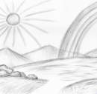
Week 3 — Lesson 3 (Part 1/4)
The Weather and Feelings
Vocabulary - Grammar Point
NMF - a sign that doesn’t use lip-pattern but instead uses expression to
dramatise the idea of the sign
Cheap - NMF
Expensive - NMF
You Can Sign! | British Sign Language Level 1
Slide 32

Slide 33
Week 3 — Lesson 3 (Part 2/4)
How much?
Buy
Pay
Age
How old?
Years Old
Very old - NMF
Young
Non- Manual Features
You Can Sign! | British Sign Language Level 1
Slide 33

Slide 34
Week 3 — Lesson 3 (Part 3/4)
Happy - NMF
Sad - NMF
Amazing - NMF
Favourite - NMF
Exciting - NMF
Nice
Beautiful - NMF
Horrible
Perfect
You Can Sign! | British Sign Language Level 1
Slide 34

Slide 35
Week 3 — Lesson 3 (Part 4/4)
Like / Don’t Like
Sleep/Sleepy
Tired
Love
But
Like what? (similar to what? Or example what?)
You Can Sign! | British Sign Language Level 1
Slide 35

Slide 36
Week 3 — Task (Part 1/2)
A. You age what?
B. Me age _____ years old
A. Me age _____, Very Old !
B. No you young
Recap Grammar point - Question words
What
Who
When
You Can Sign! | British Sign Language Level 1
Slide 36

Slide 37
Week 3 — Task (Part 2/2)
Where
Why
How
Which
How could you add question words into the following to make the signs clearer to a
receiver?
Me go work Swindon
Me go 6.30am morning
Me tired usually me wake up 9am.
You Can Sign! | British Sign Language Level 1
Slide 37

Slide 38
Week 3 — Weather Holidays (Part 1/5)
Rain - NMF
Sun / Sunny
Snow
Ice
Hail
Windy
Storm - NMF
Foggy / Cloudy
You Can Sign! | British Sign Language Level 1
Slide 38

Slide 39
Week 3 — Weather Holidays (Part 2/5)
Thunder / Lightning
Spring
Summer
Autumn
Winter
Hot - NMF
Warm
Cold
Freezing - NMF
You Can Sign! | British Sign Language Level 1
Slide 39

Slide 40
Week 3 — Weather Holidays (Part 3/5)
General Vocabulary
Holiday
Degrees
Wow
Weeks
Walk
Arrive
School
Job / Work
You Can Sign! | British Sign Language Level 1
Slide 40

Slide 41
Week 3 — Weather Holidays (Part 4/5)
Finish
This year
Today
Perfect - NMF
Love - NMF
Horrible - NMF
London
Paris
Practise these sentences using weather, time and numbers.
You Can Sign! | British Sign Language Level 1
Slide 41

Slide 42
Week 3 — Weather Holidays (Part 5/5)
A. 2020 me go holiday 2 weeks. Weather nice 35 degrees
B. Wow! Hot! Me no like hot. Me like cold weather
A. This year summer awful! Sun where?
B. Me no like weather where UK
A. You school time finish what? 3.30?
B. Around 4.15pm
A. You arrive home time what?
B. Before 5pm
You Can Sign! | British Sign Language Level 1
Slide 42

Slide 43
Week 3 — Try these weather sentences (Part 1/2)
1. Winter, this year freezing!!! Me no like cold weather
2. Me love Autumn! why? Beautiful! Amazing walks
3. Me like spring, why? Lots sunshine, me happy!
Complete the following for homework or during class time.
Answer these questions with your own information to form a script to sign
that’s relevant to you.
Example : Good evening, me name Anna, today autumn day, weather what
cloudy. Me don’t like cloudy weather today.
You Can Sign! | British Sign Language Level 1
Slide 43

Slide 44
Week 3 — Try these weather sentences (Part 2/2)
Me think beautiful where Paris, me think horrible where London. Me favourite place
where Ireland, perfect, me love!
Good evening, me name ________________. Today,
(season)_______________ day, weather what? _________and ________.
Me (like/don’t like) weather today. Me think beautiful where (place fingerspell)
____________________________ me think horrible where (place
fingerspell)__________. Me favourite place where _____________________
perfect, me love!
You Can Sign! | British Sign Language Level 1
Slide 44

Slide 45
WEEK 4
Days and Months
You Can Sign! | British Sign Language Level 1
Slide 45

Slide 46
Week 4 — Lesson 4 (Part 1/4)
Days & Months
Recap
Alphabet
Q, S, T, K, P / D - Do you know these letters?
Greetings - Good Morning, Good Afternoon, How are you?
Numbers 1-1000
Time
O’clock, half past
You Can Sign! | British Sign Language Level 1
Slide 46

Slide 47
Week 4 — Lesson 4 (Part 2/4)
Quarter to (uses timeline C)
Quarter Past
Minutes to / Past
Early
Late
Before (uses timeline A)
After
Try these:
14.12
You Can Sign! | British Sign Language Level 1
Slide 47

Slide 48
Week 4 — Lesson 4 (Part 3/4)
18.55
19.31
General Vocabulary
Understand/Know
Sorry
Please sign slowly
Repeat
Home/ Work/ School
Do
You Can Sign! | British Sign Language Level 1
Slide 48

Slide 49
Week 4 — Lesson 4 (Part 4/4)
Recap - Question Words
You Can Sign! | British Sign Language Level 1
Slide 49

Slide 50
Week 4 — Vocabulary- Days of the week (Part 1/4)
Monday - MM
Tuesday - TT
Wednesday - WW
Thursday - TH
Friday
Saturday
Sunday
Vocabulary - Months of the year
You Can Sign! | British Sign Language Level 1
Slide 50

Slide 51
Week 4 — Vocabulary- Days of the week (Part 2/4)
January - Jan
February - Feb
March - Mar
April - AA or APR
May
June - Jun
July - Jul
August - Aug
September - SS or Sept
You Can Sign! | British Sign Language Level 1
Slide 51

Slide 52
Week 4 — Vocabulary- Days of the week (Part 3/4)
October - Oct
November - Nov
December - Dec
Discussion - How to Express 1st, 2nd, 3rd etc.
Discussion - How to sign years - 2020, 2000, 1999
Vocabulary for Exercise
Date
Birthday / Born
Task - Share with your partner important dates in your life.
You Can Sign! | British Sign Language Level 1
Slide 52

Slide 53
Week 4 — Vocabulary- Days of the week (Part 4/4)
Structured Example.
Me birthday when? Me born January. 4th January 1990. Weather like what
January snowy.
Me birthday when? Me born __________ (month) Date _________(date). Weather
like what ________(type of weather).
You Can Sign! | British Sign Language Level 1
Slide 53

Slide 54
Week 4 — Expressing the Past, Present and Future (Part 1/4)
(Timeline A)
Yesterday
Today
Tomorrow
Day / Night/ Morning/ Afternoon/Evening
Last / This / Next
Yesterday / Now / Tomorrow
Week
You Can Sign! | British Sign Language Level 1
Slide 54

Slide 55
Week 4 — Expressing the Past, Present and Future (Part 2/4)
Weekly / Every Week
Last Week
This Week
Next Week
Month
Monthly / Every Month
Last Month
This Month
Next Month
You Can Sign! | British Sign Language Level 1
Slide 55

Slide 56
Week 4 — Expressing the Past, Present and Future (Part 3/4)
Year
Yearly / Every Year
Last Year
This Year
Next Year
General Vocabulary
Weekend
Later
Everyday
You Can Sign! | British Sign Language Level 1
Slide 56

Slide 57
Week 4 — Expressing the Past, Present and Future (Part 4/4)
Date
Phrases to Practise
Today's date what? _________
Day tomorrow what? _________
Yesterday me go where __________
Last Weekend you do what? ________
Next month you go where? ________
You Can Sign! | British Sign Language Level 1
Slide 57

Slide 58
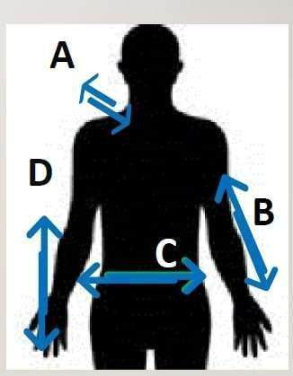
Week 4 — Grammar Point - Timelines. (Part 1/2)
Timeline A
Shoulder height dominant side
Show Past | Present Future
Example - Yesterday, Today, Tomorrow
Last, This, Next
Last week (w)
You Can Sign! | British Sign Language Level 1
Slide 58

Slide 59
Week 4 — Grammar Point - Timelines. (Part 2/2)
This year (y)
Next Month (m)
Timeline C
6-8 inches in front of the chest, moving from the dominant side to dominant side.
A - B
Example - 9am - 5pm , London - Paris
Monday-Friday
We will look at other timelines later.
You Can Sign! | British Sign Language Level 1
Slide 59

Slide 60
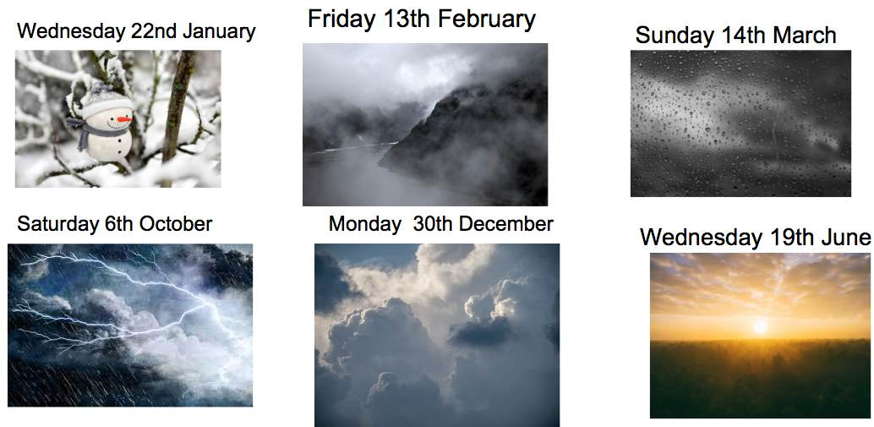
Week 4 — Extension - complete in class or for homework
You Can Sign! | British Sign Language Level 1
Slide 60

Slide 61
WEEK 5
Sentence Structure and Gesturing
You Can Sign! | British Sign Language Level 1
Slide 61

Slide 62
Week 5 — Lesson 5 (Part 1/3)
Sentence Structure and Gesturing
British Sign Language (BSL) grammar works differently from spoken languages
because it’s based on using visual and spatial clues instead of words.
In BSL, signers use the space around their body, their facial expressions, and
specific movements to show meaning and structure in their sentences.
One important part of BSL is spatial referencing—signers use different places in
space to show who or what they’re talking about, as well as actions. This makes it
easy to show ideas and connections between people or things.
You Can Sign! | British Sign Language Level 1
Slide 62

Slide 63
Week 5 — Lesson 5 (Part 2/3)
Facial expressions and body movements are also very important. Things like
eyebrow raises, head tilts, and mouth shapes help to show if a sentence is a
question, a statement, or a command, and they can also show feelings or add extra
meaning.
Another key part of BSL grammar is a topic-comment structure. First, signers
introduce the time first, place, or main subject, and then they add extra information
about it. This makes communication clearer and easier to follow.
Plan your statements in the order of:
Time + Main topic + Other Information
You Can Sign! | British Sign Language Level 1
Slide 63

Slide 64
Week 5 — Lesson 5 (Part 3/3)
Examples
• 2020 UK popular food choice what? Cheese which cheddar.
• This weekend London people enjoyed sunshine where Hyde Park how many
6,000!
• Saturday me also me friend name what Lucy go river thames why kayak
sunshine beautiful, nice time.
You Can Sign! | British Sign Language Level 1
Slide 64

Slide 65
Week 5 — 3 Steps to Start “thinking” in BSL structure (Part 1/3)
To start to translate English into BSL as a beginner follow these three simple
rules.
1. Change “I” to “Me”
2. Remove all the small words such as: so, for, a, the, and, in, it, the, as,
3. Put the time at the beginning
Task - convert these into BSL structure.
Vocabulary for Exercise
Woman
You Can Sign! | British Sign Language Level 1
Slide 65

Slide 66
Week 5 — 3 Steps to Start “thinking” in BSL structure (Part 2/3)
Man
Children
Stay
Read a book
Me think
Drive
Next door
Project
*Remember to add questions words where you think this will help make the
You Can Sign! | British Sign Language Level 1
Slide 66

Slide 67
Week 5 — 3 Steps to Start “thinking” in BSL structure (Part 3/3)
sentence meaning clearer.
1. I think I’ll stay at home and read a book tomorrow.
2. The woman who lives next door bought a new car yesterday.
3. I need to drive the children to school before I go to work.
4. My friend was tired, he stayed up late to finish his project.
You Can Sign! | British Sign Language Level 1
Slide 67

Slide 68
Week 5 — Task : Write 3 sentences in English about what you did this week. Rewrite your
sentences in sign order.
1.
2.
3.
Extension - if you have time use the sign dictionary on your phone to look up the
vocabulary you would need to sign the sentences. .
You Can Sign! | British Sign Language Level 1
Slide 68

Slide 69
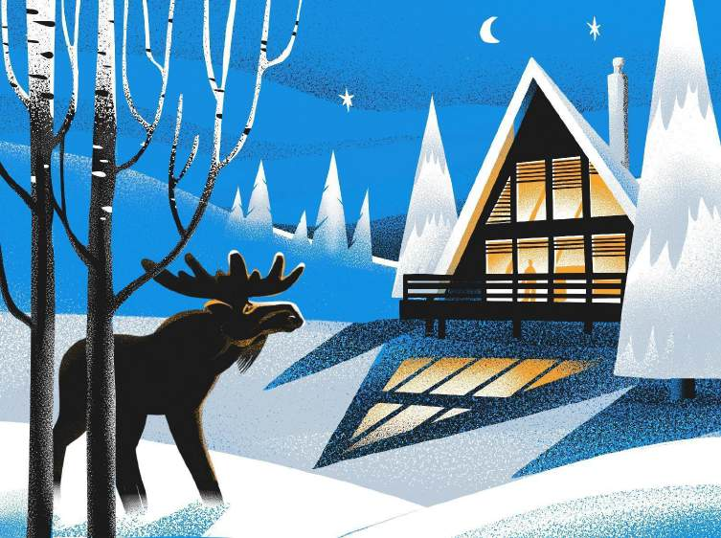
Week 5 — Exploring Gesture (Part 1/2)
You may have noticed that BSL uses less words than English. This does not mean it
is less complex. It only means that “meaning” isn’t carried as much by words and
there is more emphasis on gesture and facial expression than in English.
Task: Describe these weather related images to a partner using gestures. If you do
not know a sign you can look it up or just try and act it out and get the message
across. Consider the emotions of the characters, the atmosphere, where things are
You Can Sign! | British Sign Language Level 1
Slide 69

Slide 70
Week 5 — Exploring Gesture (Part 2/2)
in the scene.
1. Name the moose. What is the weather? What month and day is it? What
time of day is it? How do they feel about it? Can you sign the number of
items?
You Can Sign! | British Sign Language Level 1
Slide 70

Slide 71
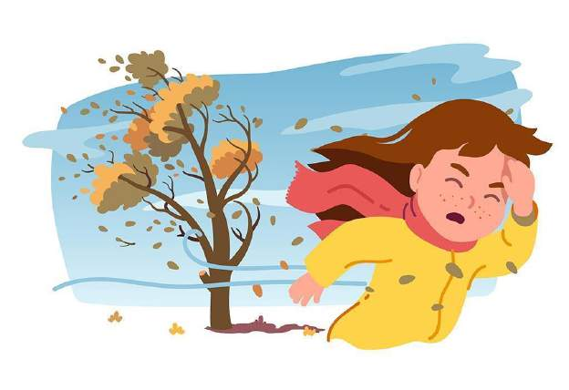
Week 5 — 2, Name the people. What is the weather? What month and day is it? What time of
day is it? How do they feel about it? Can you gesture what is happening?
3. Name the people. What is the weather? What month and day is it? What time of
day is it? How do they feel about it? Can you sign the number of items?
You Can Sign! | British Sign Language Level 1
Slide 71

Slide 72
Week 5 — Extension Task (Part 1/2)
Grammar - Using Timeline B to talk about weeks
At level 1 you can happily stick to using timeline A (over and in front of the
shoulder) to express weeks in terms of this, last and next week.
As you watch native signers, however, you may notice how timeline B (your
non-dominant forearm) is used to express ideas about the coming or previous
weeks.
If you choose not to use this yourself at this level, it is worth being aware of when
watching others sign.
You Can Sign! | British Sign Language Level 1
Slide 72

Slide 73
Week 5 — Extension Task (Part 2/2)
Timeline B is also used to express the idea of “slow” and “long” .
Weekly
This week
Next week
2 weeks time
3 weeks time
Last week
2 weeks ago
3 weeks ago
You Can Sign! | British Sign Language Level 1
Slide 73

Slide 74
WEEK 6
Pets, Colours and Placement
You Can Sign! | British Sign Language Level 1
Slide 74

Slide 75
Week 6 — Lesson 6 (Part 1/5)
Pets, Colours and Placement
Pets and Animals of Britain Colours
Pets
Animal
Bird
Cat
Cow
Dog
You Can Sign! | British Sign Language Level 1
Slide 75

Slide 76
Week 6 — Lesson 6 (Part 2/5)
Duck
Fish
Goat
Horse
Hamster
Pig
Rabbit
Squirrel
Sheep
You Can Sign! | British Sign Language Level 1
Slide 76

Slide 77
Week 6 — Lesson 6 (Part 3/5)
Red
Yellow
Pink
Green
Orange
Purple
Blue
Grey
Gold
You Can Sign! | British Sign Language Level 1
Slide 77

Slide 78
Week 6 — Lesson 6 (Part 4/5)
Silver
Bronze
Brown
Black
White
Ginger
Rainbow
Light / Dark
Bright
You Can Sign! | British Sign Language Level 1
Slide 78

Slide 79
Week 6 — Lesson 6 (Part 5/5)
Sign the following
• 7 red birds
• 18 goldfish
• 2 black dogs, name what Smoky / Kit.
• 5 white rabbits
• 10 ducks 2 colours green also brown
• 1 pink pig name what Jeremy
• 1 ginger cat name what Marmalade
• 3 silver fish
You Can Sign! | British Sign Language Level 1
Slide 79

Slide 80
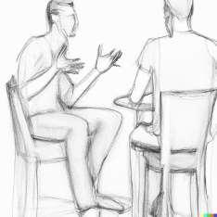
Week 6 — Vocabulary - Descriptions (Part 1/5)
Large
Small
Good
Nice
Sleepy
Bad
You Can Sign! | British Sign Language Level 1
Slide 80

Slide 81
Week 6 — Vocabulary - Descriptions (Part 2/5)
Naughty
Favourite
Like / Don’t like
Scary
Love
Cute / Sweet
Lazy
Grumpy
Lots / Many
You Can Sign! | British Sign Language Level 1
Slide 81

Slide 82
Week 6 — Vocabulary - Descriptions (Part 3/5)
Funny (amusing)
Me think
Look what
Try these:
• Me 1 dog large black name what “Marmite” dog - sleepy, lazy
• Me friend name what Zara, cat naughty also scary, me no like cat.
• Me 2 birds which? BUDGIE (fs) 1 grumpy, 1 cute. Grumpy bird me favourite.
Why? Funny.
BSL Grammar- Placements
You Can Sign! | British Sign Language Level 1
Slide 82

Slide 83
Week 6 — Vocabulary - Descriptions (Part 4/5)
Placements can be used in sign to help aid storytelling
or to demonstrate specific details.
For example, you could use this when you are telling a
story about several people, animals or objects and you
need to make your meaning clear.
In this explanation the word “subject” will be used to
represent the person,animal or object doing the main
action.
You achieve placement by stating the subject first, placing them into an area by
You Can Sign! | British Sign Language Level 1
Slide 83

Slide 84
Week 6 — Vocabulary - Descriptions (Part 5/5)
pointing and then continuing your explanation of the scenario.
You can then refer back to them (known as referents) without stating their names
You Can Sign! | British Sign Language Level 1
Slide 84

Slide 85
Week 6 — or what they are etc- the viewer remembers who/what is in each position. (Part 1/4)
Example
Me 1 horse, (points to an area to place the horse) name what? Benny, (point back
again to referent, horse) naughty.
*It is up to the person receiving your sign to remember who or what is placed
where.
To help make it easier, the signer can state the subject's name via lip pattern or by
signing the first letter of the name again. This is not essential ( and native singers
will not likely need this) but this is totally acceptable for learners and shows that
You Can Sign! | British Sign Language Level 1
Slide 85

Slide 86
Week 6 — or what they are etc- the viewer remembers who/what is in each position. (Part 2/4)
you are signing with clarity in mind.
Lets try these together
1. Me cat (place) colour what? Black and White
2. Me 4 pets, place
1 Cat (place) 1 dog (place) also 2 goats (place)
Refer back to your places - Cat name what? Whiskey
Refer back - Dog name what? Lassie
Refer back - Goats names what
Refer back - Billy also Bob
You Can Sign! | British Sign Language Level 1
Slide 86

Slide 87
Week 6 — or what they are etc- the viewer remembers who/what is in each position. (Part 3/4)
Now you have your animals placed, give some details about them, each time
pointing back to where you have “placed” the animal.
Whiskey (point) nice
Lassie (point) sleeps lots
Billy and Bob (point) cute
Task: Try doing this for your own pets of the past or present.
Vocabulary
How Many?
How Old?
You Can Sign! | British Sign Language Level 1
Slide 87

Slide 88
Week 6 — or what they are etc- the viewer remembers who/what is in each position. (Part 4/4)
Age
Birthday
You Can Sign! | British Sign Language Level 1
Slide 88

Slide 89
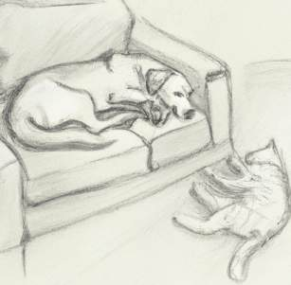
Week 6 — Recap - Emotions and Responses (Part 1/4)
Wow
Fantastic - NMF
Perfect - NMF
Love - NMF
Hate - NMF
Horrible - NMF
You Can Sign! | British Sign Language Level 1
Slide 89

Slide 90
Week 6 — Recap - Emotions and Responses (Part 2/4)
Happy- NMF
Sad - NMF
Nervous - NMF
Amazing - NMF
Favourite - NMF
Exciting - NMF
Interesting - NMF
Really
Nice
You Can Sign! | British Sign Language Level 1
Slide 90

Slide 91
Week 6 — Recap - Emotions and Responses (Part 3/4)
Beautiful - NMF
Like / Don’t Like - NMF optional
Sleep/Sleepy - optional NMF
Tired - NMF
But
Like what? (meaning “similar to for example” )
Task
Have a conversation about pets past and
present. Try to add your emotion words and
You Can Sign! | British Sign Language Level 1
Slide 91

Slide 92
Week 6 — Recap - Emotions and Responses (Part 4/4)
respond to your partner with emotion.
Include things like
• Name of pets
• How many pets?
• Type of pet
• Age
• Colour
• What's he / she like / look like
You Can Sign! | British Sign Language Level 1
Slide 92

Slide 93
WEEK 7
Transport and Directions
You Can Sign! | British Sign Language Level 1
Slide 93

Slide 94
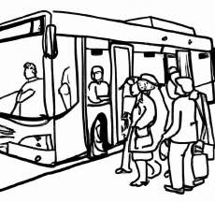
Week 7 — Lesson 7 (Part 1/5)
Transport and directions
Forms of Transport Directions
Bike
Motorbike / Scooter
Bus
Caravan
You Can Sign! | British Sign Language Level 1
Slide 94

Slide 95
Week 7 — Lesson 7 (Part 2/5)
Car
Van
Lorry
Boat
Train
Tube
Plane
Taxi
Work
You Can Sign! | British Sign Language Level 1
Slide 95

Slide 96
Week 7 — Lesson 7 (Part 3/5)
School
Tent
Stay
Miles
Kilometres
Arrive
Leave / Go
How long?
Up
You Can Sign! | British Sign Language Level 1
Slide 96

Slide 97
Week 7 — Lesson 7 (Part 4/5)
Down
Left
Right
Upstairs
Downstairs
Straight
Corner
Opposite
Bridge
You Can Sign! | British Sign Language Level 1
Slide 97

Slide 98
Week 7 — Lesson 7 (Part 5/5)
Next to
Door
Window
Floor
Ground Floor
1st Floor
Corridor
Exit / Escape
Journey
You Can Sign! | British Sign Language Level 1
Slide 98

Slide 99
Week 7 — Try these in pairs… (Part 1/2)
Me travel work how _______
Me drive ___ mins / ___ miles
Me go work train / Bus / Walk/ Taxi
Me no travel! me work from home
You travel work how?
Conversation practice
A. Excuse me (sorry) Toilet where please
B. Toilets? Upstairs, 2nd floor turn right
You Can Sign! | British Sign Language Level 1
Slide 99

Slide 100
Week 7 — Try these in pairs… (Part 2/2)
A. Me love travelling train, you?
B. Yes but expensive !!
A. My office next to bus station also train station!
B. Wow busy also noisy?
A. Yes (very)
A. Me no like driving motorway why? Boring
B. Really ! Me love driving ! me drive lots !
You Can Sign! | British Sign Language Level 1
Slide 100

Slide 101
Week 7 — Amenities Daily Activities (Part 1/6)
Airport
Ambulance
Fire Station
Hospital
Hotel
How long?
Local
Office
You Can Sign! | British Sign Language Level 1
Slide 101

Slide 102
Week 7 — Amenities Daily Activities (Part 2/6)
Park
Police Station
Port
Shop
Street
Town Centre
With
Friend
Partner
You Can Sign! | British Sign Language Level 1
Slide 102

Slide 103
Week 7 — Amenities Daily Activities (Part 3/6)
Busy
Quiet
Relaxing
Chat / Talk
Cinema
Drive
Drink coffee/tea/water
Eat
Go coffee shop
You Can Sign! | British Sign Language Level 1
Slide 103

Slide 104
Week 7 — Amenities Daily Activities (Part 4/6)
Gym/Exercise
Have a meal
Listen to music
Look on internet
Meet
Movies
Pub
Read
Shop
You Can Sign! | British Sign Language Level 1
Slide 104

Slide 105
Week 7 — Amenities Daily Activities (Part 5/6)
Supermarket
TV
Walk
Walk dog
Visit
Hours
Try these:
1. Every Monday me meet me friend name what? Akeel, around 1pm, do what?
go coffee shop, drink 2 coffees, sometimes lunch, also chat. Fun!
You Can Sign! | British Sign Language Level 1
Slide 105

Slide 106
Week 7 — Amenities Daily Activities (Part 6/6)
2. Sunday morning, 11am me walk dog, where? park, how long, 3 miles, after
me tired but happy.
3. Friday night around 8.30pm me go pub, with who? me partner, why? me work
busy, need relax. How long? 2 hours.
You Can Sign! | British Sign Language Level 1
Slide 106

Slide 107
Week 7 — Complete this task for homework or during class time. (Part 1/3)
Train to Manchester roleplay
Manchester - MC
Pub
Roundabout
Traffic Light
Station
Better
Alan – Hi, good see you!
You Can Sign! | British Sign Language Level 1
Slide 107

Slide 108
Week 7 — Complete this task for homework or during class time. (Part 2/3)
Brenda – Hi, how are you?
Alan – Me good! Yesterday me saw who? Sheila. Next weekend you see Sheila?
Brenda – Yes! We go Manchester, how? Train.
Alan – Nice! You meet Sheila time what?
Brenda – Quarter past 10. Where? George Street.
Alan – Don’t know street. Where?
Brenda – Next pub, name what? White Horse.
Alan – Me know pub! Next roundabout, opposite traffic light. You leave time what?
Brenda – leave station 10.30am, arrive 10 mins past 11.
You Can Sign! | British Sign Language Level 1
Slide 108

Slide 109
Week 7 — Complete this task for homework or during class time. (Part 3/3)
Alan – you travel home station how?
Brenda – First walk, after bus.
Alan – Me think better taxi?
Brenda – Maybe… you know how much?
Alan – Around £20.
Brenda – Expensive! Me think bus better.
Alan – Agree! Have nice time!
You Can Sign! | British Sign Language Level 1
Slide 109

Slide 110
Week 7 — Task (Part 1/2)
Describe a typical route from your home to somewhere you regularly go.
You could sign :
• How long it takes
• How often you take the route
What you see on the way
• Directions
• How many miles/kilometres
Write any notes here:
You Can Sign! | British Sign Language Level 1
Slide 110

Slide 111
Week 7 — Task (Part 2/2)
Extension Task
Go back to the previous week’s extension tasks or recap previous vocabulary if
you have the time.
You Can Sign! | British Sign Language Level 1
Slide 111

Slide 112
WEEK 8
Leisure and Family
You Can Sign! | British Sign Language Level 1
Slide 112

Slide 113
Week 8 — Lesson 8 (Part 1/5)
Family
Family
Father / Dad
Mum / Mother
Parents
Man
Woman / Lady
Husband
You Can Sign! | British Sign Language Level 1
Slide 113

Slide 114
Week 8 — Lesson 8 (Part 2/5)
Wife
Married
Divorced
Separated
Single
Son
Daughter
Sister
Brother
You Can Sign! | British Sign Language Level 1
Slide 114

Slide 115
Week 8 — Lesson 8 (Part 3/5)
None
Only Child
Boy
Child / Children
Girl
Baby
Friend
Boyfriend
Girlfriend
You Can Sign! | British Sign Language Level 1
Slide 115

Slide 116
Week 8 — Lesson 8 (Part 4/5)
Aunty / Uncle / Niece / Nephew
Cousin
Step _(relation
Grandmother / Grandma
Nan
Grandfather
Sign the following using placement where relevant.
Me 2 brother, name what? Ryan (place) also Jacob (place) age what? (refer back)
23 (refer back) 30. Me parents (place) live where? Glasgow. Me visit 3 times every
You Can Sign! | British Sign Language Level 1
Slide 116

Slide 117
Week 8 — Lesson 8 (Part 5/5)
year. Journey, how long? 7 hours.
What do you notice about the grammar?
• No plurals
• Use “me” not “my” for family members e.g. me mother, me father, me sister. (nouns
imply ownership)
• Question words at the end.
You Can Sign! | British Sign Language Level 1
Slide 117

Slide 118
Week 8 — Task 1 ) Write 2 sentences about your family activities in English grammar. (Part 1/2)
1.
2.
Task 2) These sentences demonstrate the new vocabulary and BSL structure.
Practise signing these alone or in pairs.
1. 10am, me meet friend where? Luton Airport.
2. Afternoon, me go where? Hospital St. Ann's with Mum.
3. 3pm, me meet with partner where? Cafe Bean.
4. This morning, me walk dog where? West Park.
You Can Sign! | British Sign Language Level 1
Slide 118

Slide 119
Week 8 — Task 1 ) Write 2 sentences about your family activities in English grammar. (Part 2/2)
5. 6pm, me eat meal with who? family where? Oak Tree Pub.
6. Saturday morning, me shop where? Westgate with who? daughter.
Task 3) Now rewrite your sentences using sign order.
Time - main topic - extra detail.
Remember - remove the small words, change “I” for me, start with the time.
1.
2.
You Can Sign! | British Sign Language Level 1
Slide 119

Slide 120
Week 8 — Recap time vocabulary (Part 1/6)
O'clock
Half Past
Quarter Past
Quarter to
Minutes past
Minutes to
Go
Start
You Can Sign! | British Sign Language Level 1
Slide 120

Slide 121
Week 8 — Recap time vocabulary (Part 2/6)
Finish
Early
Before
After
Late
Tomorrow
Yesterday
Visit
Pound
You Can Sign! | British Sign Language Level 1
Slide 121

Slide 122
Week 8 — Recap time vocabulary (Part 3/6)
Pence
Money
Afternoon
Morning
Night
Evening
Age
How old?
Years Old
You Can Sign! | British Sign Language Level 1
Slide 122

Slide 123
Week 8 — Recap time vocabulary (Part 4/6)
Very old - NMF
Young
Spring
Summer
Autumn
Winter
Degrees
Weeks
Sign the following story in class or on your own for homework
You Can Sign! | British Sign Language Level 1
Slide 123

Slide 124
Week 8 — Recap time vocabulary (Part 5/6)
Family Day Out
Yesterday morning, time quarter past 8, me mum dad work go. Me sister, young,
school go, time half past 8. After, me grandfather, very old (NMF), visit. Age what 82
years old!
Afternoon, me uncle, aunty, visit. Arrive time what around 2:30 PM. We chat topic
what weather – spring, summer, autumn, winter. Today, weather what 12 degrees.
Time quarter to 6, me brother, home come, work finish. Brother late. Dinner, start
time 6 o’clock, finish time 20 minutes past 7.
After dinner, me cousin, ask grandfather – you age what?
You Can Sign! | British Sign Language Level 1
Slide 124

Slide 125
Week 8 — Recap time vocabulary (Part 6/6)
Grandfather laugh, "Very old!" (NMF).
Later evening, me mum, me brother, money £10 also 50 pence give, why? Help
mum drive. Night, 10 PM, we all bed, sleep, tired, long day but happy!
You Can Sign! | British Sign Language Level 1
Slide 125

Slide 126
WEEK 9
Descriptions and Clothes
You Can Sign! | British Sign Language Level 1
Slide 126

Slide 127
Week 9 — Lesson 9 - Descriptions and Clothes (Part 1/4)
Task 1 - Recap family members
Vocabulary - Descriptions
Big / Small
Curly
Cute/Sweet
Died
Glasses
Handsome/Pretty
You Can Sign! | British Sign Language Level 1
Slide 127

Slide 128
Week 9 — Lesson 9 - Descriptions and Clothes (Part 2/4)
Long
Mustache
Old
Pregnant
Short
Slim / Diet
Straight
Strong
Tall
You Can Sign! | British Sign Language Level 1
Slide 128

Slide 129
Week 9 — Lesson 9 - Descriptions and Clothes (Part 3/4)
Ugly
Young
Like what? (example)
Recap - colours
Colours - red, yellow, pink, green,
orange, purple, blue
Black, white, grey
Brown
Gold, silver, bronze
You Can Sign! | British Sign Language Level 1
Slide 129

Slide 130
Week 9 — Lesson 9 - Descriptions and Clothes (Part 4/4)
Try these
1. Me have two brothers, also one sister. Favourite who? Me!
2. Me wife slim, tall also beautiful
3. Me brother very tall! Black beard also moustache
4. Me big family, four brothers and seven sisters !
Use this space to write details about your own family. Include names and
numbers where possible.
You Can Sign! | British Sign Language Level 1
Slide 130

Slide 131
Week 9 — Task - Have a conversation with a partner about your family (Part 1/2)
Example Questions
You Family what? Names what?
How many people?
You children? How many children? Ages what?
You partner?
You parents married? You family live where?
You sister/father/cousin look what?
Example statements
You Can Sign! | British Sign Language Level 1
Slide 131

Slide 132
Week 9 — Task - Have a conversation with a partner about your family (Part 2/2)
Me family big / small
Me ___ Brothers __ sisters
Brother / sister name what
My Mum age what? my Dad age what?
My parents married / separated / divorced / died
Me married 2 children
age/s what? ____ years old
Notes
You Can Sign! | British Sign Language Level 1
Slide 132

Slide 133
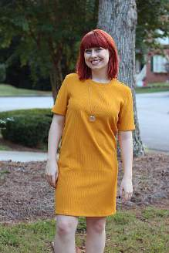
Week 9 — Vocabulary: Clothes (Part 1/3)
T-shirt
Shirt
Scarf
Jumper
Hat
Coat / Jacket
You Can Sign! | British Sign Language Level 1
Slide 133

Slide 134
Week 9 — Vocabulary: Clothes (Part 2/3)
Tie
Dress
Skirt
Trousers
Boots
Socks
Shorts
Shoes
Hat / Cap
You Can Sign! | British Sign Language Level 1
Slide 134

Slide 135
Week 9 — Vocabulary: Clothes (Part 3/3)
Glasses
Wear
Describe what you like to wear
Me like wear what?
Me like buying what?
Me buy lots shoes etc
Describe the Following, using colours and other descriptions that you have
learned so far.
You Can Sign! | British Sign Language Level 1
Slide 135

Slide 136
Week 9 — Try the following script: (Part 1/5)
New vocabulary and vocabulary recap for script
Pet
Cute
Fluffy
Sweet
Young
Love
Animal
You Can Sign! | British Sign Language Level 1
Slide 136

Slide 137
Week 9 — Try the following script: (Part 2/5)
Bright
Lovely
Favourite
Relaxing
Long
Usually
Bus
Stay Home
Read
You Can Sign! | British Sign Language Level 1
Slide 137

Slide 138
Week 9 — Try the following script: (Part 3/5)
Lots
Book
Dog
Cat
A: You pets?
B: Yes. One dog. Name what? Max. Small, curly hair. Cute. You pets?
A: Yes. Cat. Name what? Luna. Big, fluffy. Sweet.
B: You cat good?
A: Sometimes grumpy.
You Can Sign! | British Sign Language Level 1
Slide 138

Slide 139
Week 9 — Try the following script: (Part 4/5)
B: You family who?
A: Brother, sister. Sister tall, slim. Brother short!, glasses.
B: Me sister also. Young, 15, love animals.
A: Nice. Me like you jumper. Bright green, lovely. You favourite colour what?
B: Red. Strong.
A: Me like blue, why relaxing.
B: Me blue shoes but home today..
A: You home travel how?
B: Usually walk. Me love long walk.
You Can Sign! | British Sign Language Level 1
Slide 139

Slide 140
Week 9 — Try the following script: (Part 5/5)
A: Me like bus. Me no like exercise. Like stay home, read..
B: Read what?
A: Lots things, now me read book Stephen King, name what Carrie.
You Can Sign! | British Sign Language Level 1
Slide 140

Slide 141
WEEK 10
Recap
You Can Sign! | British Sign Language Level 1
Slide 141

Slide 142
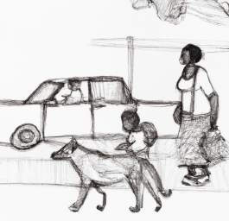
Week 10 — Lesson 10 - Recap (Part 1/3)
Animals Notes
Pets
Animal
Bird
Cat
Dog
You Can Sign! | British Sign Language Level 1
Slide 142

Slide 143
Week 10 — Lesson 10 - Recap (Part 2/3)
Fish
Horse
Pig
Rabbit
Descriptions
But
Love
Large / Small
Good / Bad
You Can Sign! | British Sign Language Level 1
Slide 143

Slide 144
Week 10 — Lesson 10 - Recap (Part 3/3)
Naughty
Favourite
Like / Don’t Like
Job
London
Everyday
Travel
Train
You Can Sign! | British Sign Language Level 1
Slide 144

Slide 145
Week 10 — Transport, Leisure (Part 1/8)
Directions
Family Clothes
Bike
Caravan
Car
Train
Tube
Plane
You Can Sign! | British Sign Language Level 1
Slide 145

Slide 146
Week 10 — Transport, Leisure (Part 2/8)
Police
Travel
Walk
Arrive
Leave
Meet
Next to
Door
Floor
You Can Sign! | British Sign Language Level 1
Slide 146

Slide 147
Week 10 — Transport, Leisure (Part 3/8)
Ground Floor
1st floor
Exit
Strong
Father
Dad
Mum
Mother
Parents
You Can Sign! | British Sign Language Level 1
Slide 147

Slide 148
Week 10 — Transport, Leisure (Part 4/8)
Boy
Girl
Son
Daughter
Sister
Brother
Child / Children
Husband
Wife
You Can Sign! | British Sign Language Level 1
Slide 148

Slide 149
Week 10 — Transport, Leisure (Part 5/8)
Married
Divorced
Friend
Old
Young
T-Shirt
Shirt
Coat
Shoes
You Can Sign! | British Sign Language Level 1
Slide 149

Slide 150
Week 10 — Transport, Leisure (Part 6/8)
Trousers
Dress
Points of Interest
Hotel
Work
Toilet
Cafe
Shop
School
You Can Sign! | British Sign Language Level 1
Slide 150

Slide 151
Week 10 — Transport, Leisure (Part 7/8)
Supermarket
Cinema
Responses
Interesting / Exciting
Nice!
Me Same
Really
Task
In pairs or 3s have a conversation about either:
You Can Sign! | British Sign Language Level 1
Slide 151

Slide 152
Week 10 — Transport, Leisure (Part 8/8)
• Your pets, names and ages
• Names of immediate family members
• Where do you work, how do you get there? What was the weather like this week
at work/school/home.
Think about including numbers, finger-spellings and non-manual features to show
your feelings/responses.
Suggested responses: Really? / Nice! / Interesting / Me same.
You Can Sign! | British Sign Language Level 1
Slide 152

Slide 153
Week 10 — Task
Sign Grammar
Change these sentences into BSL order including question words.
1. My daughter loves the colour purple. She has a big purple rabbit. It's so
cute!
2. This year I’m going to Barbados on holiday, I love the summer sun!
3. My friend and her wife Sandra live in Sri-lanka, it’s a beautiful place!
4. I love going to the train station when my son arrives home for the summer.
You Can Sign! | British Sign Language Level 1
Slide 153

Slide 154
Week 10 — Skills Checkpoint (Part 1/3)
Mark yourself out of 10 for the following skills to check your progress. The pass mark
for these skills is the ability to use them 50% of the time during a conversation.
Skills Tick OR grade
yourself out of 10
Answered 2-3 questions correctly from another signer.
Sign with consistent flow
Use placement correctly.
Used turn-taking correctly (meaning you have a natural 2 sided
You Can Sign! | British Sign Language Level 1
Slide 154

Slide 155
Week 10 — Skills Checkpoint (Part 2/3)
conversation)
Use non-manual features
Used a range of vocabulary
Expressed time correctly
Express numbers correctly
Finger spelled names of people and places
Used BSL grammar order rather than English
Finger spelled a word back for clarification of 4-6 letters.
Understood other person most of the time
You Can Sign! | British Sign Language Level 1
Slide 155

Slide 156
Week 10 — Skills Checkpoint (Part 3/3)
Use correct hand shape for signs
Expressed emotions and meaning through facial expressions
Use question words correctly
Use sign space correctly
Focus areas
You Can Sign! | British Sign Language Level 1
Slide 156

Slide 157
WEEK 11
Food and Drink
You Can Sign! | British Sign Language Level 1
Slide 157

Slide 158
Week 11 — Lesson 11 (Part 1/5)
Food and Drink
Breakfast Lunch Dinner/ Tea
Eggs
Bacon
Sausages
Beans
Toast
Butter
You Can Sign! | British Sign Language Level 1
Slide 158

Slide 159
Week 11 — Lesson 11 (Part 2/5)
Jam
Cereal / Porridge
Bread
Sandwich
Ham
Cheese
Pizza
Soup
Crisps
You Can Sign! | British Sign Language Level 1
Slide 159

Slide 160
Week 11 — Lesson 11 (Part 3/5)
Diet types
Vegetarian
Vegan
Pescatarian
Gluten Free
Dairy Free
Curry
Rice
Roast Dinner
You Can Sign! | British Sign Language Level 1
Slide 160

Slide 161
Week 11 — Lesson 11 (Part 4/5)
Pasta
Spaghetti Bolognese
Burger
Chips
Potato / Jacket Potato
Meats
Lamb
Chicken
Turkey
You Can Sign! | British Sign Language Level 1
Slide 161

Slide 162
Week 11 — Lesson 11 (Part 5/5)
Beef
Fish
Pork
Food today / Yesterday?
Today me breakfast what? Eggs with toast
Lunch today me ham, cheese sandwich also crisps
Dinner me tonight vegetable curry with rice. Delicious
Try this out for yourself based on what you have eaten today
You Can Sign! | British Sign Language Level 1
Slide 162

Slide 163
Week 11 — Me favourite Fruits what? (Part 1/6)
Bananas, Apples and Pineapples.
Me favourite vegetables what?
Peas, carrots and cabbage
Try this…
Me favourite fruits what?
Me favourite Vegetables what?
Drinks Other
Tea
You Can Sign! | British Sign Language Level 1
Slide 163

Slide 164
Week 11 — Me favourite Fruits what? (Part 2/6)
Coffee
Milk
Sugar
Hot Chocolate
Water
Orange Juice
Beer
Wine
Takeway
You Can Sign! | British Sign Language Level 1
Slide 164

Slide 165
Week 11 — Me favourite Fruits what? (Part 3/6)
Indian food
Chinese food
Italian Food
Delicious
Order
Me want
Cafe
Restaurant
Try these sentences
You Can Sign! | British Sign Language Level 1
Slide 165

Slide 166
Week 11 — Me favourite Fruits what? (Part 4/6)
1. Me lunch what? Usually same. Cheese also tomato sandwich. Brown
bread.
2. Me wife loves tea. Lots teas ! Milk no sugar. Maybe 10 everyday!
3. Me breakfast, what? Always 2 eggs, tomatoes also baked beans.
4. Vegan cafe yesterday me order what? Vegan bacon also beans with toast !
Fruit Vegetables
Apple / Pears
Banana
Grapes
You Can Sign! | British Sign Language Level 1
Slide 166

Slide 167
Week 11 — Me favourite Fruits what? (Part 5/6)
Orange
Strawberries
Pineapple
Melon / Watermelon
Tomatoes
Carrots
Mushrooms
Cucumber
Peas
You Can Sign! | British Sign Language Level 1
Slide 167

Slide 168
Week 11 — Me favourite Fruits what? (Part 6/6)
Broccoli
Peppers
Cabbage
Brussel Sprout
Salad
You Can Sign! | British Sign Language Level 1
Slide 168

Slide 169
Week 11 — 5. Lunch me eat what? Jacket Potato cheese also Marmite!
Plan a conversation using key skills
1. Think of 3 finger spellings relating to food and drink
2. Think of 2 ways that you could use numbers
3. Think of 3 emotions you could convey as non manual features.
4. Think of some questions to ask your partner
Now have a conversation with a partner about your daily food habits and any
recent experiences of eating out.
You Can Sign! | British Sign Language Level 1
Slide 169

Slide 170
Week 11 — Extension Task for lesson or home practise:order from the menu (Part 1/6)
Breakfast 🍳
• Full English > Eggs, Bacon,
Sausages, Beans, and Toast
• Cereal or Porridge with Milk (choose:
plain, honey, or fruit)
• Toast with Butter & Jam
Lunch & Dinner 🍽
• Sandwich > Choose Ham, Cheese,
You Can Sign! | British Sign Language Level 1
Slide 170

Slide 171
Week 11 — Extension Task for lesson or home practise:order from the menu (Part 2/6)
Chicken with or without salad.
• Soup with Bread (tomato, vegetable,
or chicken)
• Jacket Potato > Choose Cheese,
Beans, or Butter
• Pizza > Cheese & Tomato or
Vegetarian (peppers, mushrooms,
onions)
• Spaghetti Bolognese > tomato & beef
You Can Sign! | British Sign Language Level 1
Slide 171

Slide 172
Week 11 — Extension Task for lesson or home practise:order from the menu (Part 3/6)
sauce
• Burger & Chips > Beef, Chicken, or
Veget burger
• Roast Dinner > Choose Chicken,
Beef, or Lamb with vegetables and
gravy
• Curry with Rice > Korma, Jalfrezi or
Balti.
Snacks 🥗
You Can Sign! | British Sign Language Level 1
Slide 172

Slide 173
Week 11 — Extension Task for lesson or home practise:order from the menu (Part 4/6)
• Crisps (salted, cheese & onion, bbq,or
salt & vinegar)
• Peas, Carrots, or Broccoli
Drinks ☕
• Tea or Coffee – with or without Milk &
Sugar
• Hot Chocolate
• Water or Orange Juice
Beer or Wine (red, white, or rose (pink))
You Can Sign! | British Sign Language Level 1
Slide 173

Slide 174
Week 11 — Extension Task for lesson or home practise:order from the menu (Part 5/6)
Desserts 🍎
• Fruit – Apple, Pear, Banana, Grapes,
Orange, Strawberries, Pineapple, or
Melon
A: Hello, you want order what?
B: Me want order _________
A: You want drink what?
B: Me drink ___________
A: You dessert?
You Can Sign! | British Sign Language Level 1
Slide 174

Slide 175
Week 11 — Extension Task for lesson or home practise:order from the menu (Part 6/6)
B: Me dessert? yes/no ______
A: Thank you, food order around 20 minutes
B: Thank you!
You Can Sign! | British Sign Language Level 1
Slide 175

Slide 176
WEEK 12
Home and Hobbies
You Can Sign! | British Sign Language Level 1
Slide 176

Slide 177

Week 12 — Lesson 12: (Part 1/5)
Home and Hobbies
House / Home Kitchen
Boat
Building
Caravan
Flat / Bungalow
You Can Sign! | British Sign Language Level 1
Slide 177

Slide 178
Week 12 — Lesson 12: (Part 2/5)
Tent
Tower Block
Bookshelf
Cooker
Cupboard
Dining Table
Dishwasher
Fireplace
Fridge
You Can Sign! | British Sign Language Level 1
Slide 178

Slide 179
Week 12 — Lesson 12: (Part 3/5)
Kettle
Microwave
Sofa
Table
Toaster
TV
Washing Machine
Bathroom Bedroom
Bath / Bathtub
You Can Sign! | British Sign Language Level 1
Slide 179

Slide 180
Week 12 — Lesson 12: (Part 4/5)
Shower
Sink
Taps
Toilet
Walls
Other:
Garden
Bed
Bedroom / Hotel
You Can Sign! | British Sign Language Level 1
Slide 180

Slide 181
Week 12 — Lesson 12: (Part 5/5)
Curtains
Drawers
Doors
Lights
Pillow
Wardrobe
Windows
You Can Sign! | British Sign Language Level 1
Slide 181

Slide 182
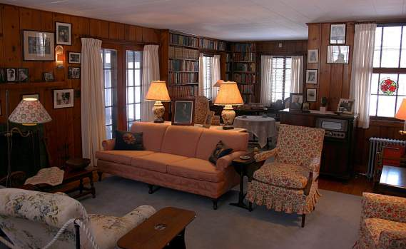
Week 12 — Describe these rooms in sign using colour, shape, and placement
You Can Sign! | British Sign Language Level 1
Slide 182

Slide 183

Week 12 — Using placement: When describing a room you can use placement very
easily by mapping out what is where.
Example:
Me desk here, my laptop here, opposite my printer, me dog sleeps here next me
computer.
Task: choose a room in your house and draw it below (if you like) and then sign it
to your partner. Use spatial placements at least 3 times to explain what is where.
You Can Sign! | British Sign Language Level 1
Slide 183

Slide 184
Week 12 — Hobbies (Part 1/4)
Sports and Hobbies
Badminton
Basketball
Boxing
Cooking
Cricket
Cycling
Dancing
You Can Sign! | British Sign Language Level 1
Slide 184

Slide 185
Week 12 — Hobbies (Part 2/4)
Favourite
Fit
Football
Gardening
Gym / Exercise
Healthy
Hobbies
Hockey / Ice Hockey
Horse riding
You Can Sign! | British Sign Language Level 1
Slide 185

Slide 186
Week 12 — Hobbies (Part 3/4)
Lazy
Movies
Music
Reading
Rugby
Running
Shopping
Sink
Swimming
You Can Sign! | British Sign Language Level 1
Slide 186

Slide 187
Week 12 — Hobbies (Part 4/4)
Tennis
Walking
with
Sentence Practice
1. Me favourite sports what? Running, football and boxing
2. Me enjoy gardening also walking. Sports? Me? No! Me lazy
3. Me love films, me go cinema every week with girlfriend
4. Gym me go 4 days week ! why? Me enjoying staying fit also healthy.
You Can Sign! | British Sign Language Level 1
Slide 187

Slide 188
Week 12 — Grammar Recap- Place your Hobbies (Part 1/2)
Try the example and then sign your own hobbies to a partner using placement. You
can also talk about sports you dislike and why.
Here is an example that you may like to try first.
Me 3 hobbies.
Rollerblading (place to left by pointing a finger to the space)
Art (place in centre by pointing a finger to the space)
Tennis (place to right by pointing finger to the space)
(point back to rollerblading) me rollerblade, young age what 14? Love!
You Can Sign! | British Sign Language Level 1
Slide 188

Slide 189
Week 12 — Grammar Recap- Place your Hobbies (Part 2/2)
(point back to art) me love art where school me draw people.
(point back to tennis) me not good tennis but enjoy, exercise good!
You Can Sign! | British Sign Language Level 1
Slide 189

Slide 190
WEEK 13
People, Places and Things
You Can Sign! | British Sign Language Level 1
Slide 190

Slide 191
Week 13 — Lesson 13 (Part 1/2)
People Animals and Objects
Productive Task - Every Day Life
Talking about Yourself
Write a small script in BSL structure about your daily life. Include things such as :
• What your morning routine is
• Where you travel to and from and why
• What you do for work / study / at home
• Hobbies and interests
You Can Sign! | British Sign Language Level 1
Slide 191

Slide 192
Week 13 — Lesson 13 (Part 2/2)
EXAMPLE
• Me work home 4 days every week but 2 days me work evenings where
Oxford also Witney.
• Me breakfast around 9am, usually cereal also tea. Me walk dog, clean
house, after start work maybe 11am.
• Me love music, me music, me work computer.
• Me work finish 8pm, me hobbies interests what , me like guitar.
Share your script with a partner
You Can Sign! | British Sign Language Level 1
Slide 192

Slide 193
Week 13 — Talking about people, animals and things (Part 1/8)
The focus of this topic is to use description and details to discuss either or all
people, animals and things in your life.
Let’s recap some descriptive words:
Useful Vocabulary Recap
Man
Woman / Girl
Boy
Baby
You Can Sign! | British Sign Language Level 1
Slide 193

Slide 194
Week 13 — Talking about people, animals and things (Part 2/8)
Child
Teenager
Adult
Friend
Teacher
Student
Mum
Dad
Brother
You Can Sign! | British Sign Language Level 1
Slide 194

Slide 195
Week 13 — Talking about people, animals and things (Part 3/8)
Sister
Grandma
Grandad
Family
Husband
Wife
Partner
How Old/ Age what?
Tall / Short
You Can Sign! | British Sign Language Level 1
Slide 195

Slide 196
Week 13 — Talking about people, animals and things (Part 4/8)
Beautiful /Handsome/pretty
Clever
Strong (person) /Strong (muscular)
Confident
Shy
Old
Young
Happy
Kind
You Can Sign! | British Sign Language Level 1
Slide 196

Slide 197
Week 13 — Talking about people, animals and things (Part 5/8)
Friendly
Funny
Noisy / Quiet
Red
Orange
Yellow
Green
Blue
Purple
You Can Sign! | British Sign Language Level 1
Slide 197

Slide 198
Week 13 — Talking about people, animals and things (Part 6/8)
Pink
Brown
Black
White
Grey
Gold
Silver
Blonde
Ginger
You Can Sign! | British Sign Language Level 1
Slide 198

Slide 199
Week 13 — Talking about people, animals and things (Part 7/8)
Bald
Hair
Short hair/long hair
Glasses
Beard
Moustache
Animals
Dog
Cat
You Can Sign! | British Sign Language Level 1
Slide 199

Slide 200
Week 13 — Talking about people, animals and things (Part 8/8)
Fish
Bird
Rabbit
Horse
Snake
Hamster
Turtle
You Can Sign! | British Sign Language Level 1
Slide 200

Slide 201
Week 13 — Now, make some notes about people and in animals in your life and how you
might describe them:
Sign with a partner
You Can Sign! | British Sign Language Level 1
Slide 201

Slide 202
Week 13 — Objects Vocabulary (Part 1/5)
Chair
Table
Bed
Lamp
Mirror
Sofa
Phone
Computer
You Can Sign! | British Sign Language Level 1
Slide 202

Slide 203
Week 13 — Objects Vocabulary (Part 2/5)
Fridge
Microwave
Kettle
Cup
Bag
Coat
Glasses
Shoes
Wallet
You Can Sign! | British Sign Language Level 1
Slide 203

Slide 204
Week 13 — Objects Vocabulary (Part 3/5)
Book
Pen
Ticket
Keys
Bag
Coat
Hat
Umbrella
Watch
You Can Sign! | British Sign Language Level 1
Slide 204

Slide 205
Week 13 — Objects Vocabulary (Part 4/5)
Book
Video Game Console
Bike
Car
House
Ticket
Notes
Grammar Point - Classifier
Using a classifier in BSL simply means using your hands to suggest the actual
You Can Sign! | British Sign Language Level 1
Slide 205

Slide 206
Week 13 — Objects Vocabulary (Part 5/5)
shape, size, breadth, length of the things you are signing.
A vase is a good example, vases can be tall, short, circular, angular - a range of
shapes and sizes. When signing about a new vase, you could adapt your hands to
show in space the dimensions of the vase you’re talking about.
You can do this for cars, boxes, suitcases, glasses, books. Many objects. In the
presentation use a classifier where you see the CSS to spatially represent the
object.
You Can Sign! | British Sign Language Level 1
Slide 206

Slide 207
Week 13 — Sign the following, consider how you could use placement and add non (Part 1/3)
manual features.
Me friend – name Sam. Sam – student, live alone, house small CSS. Living room
what – sofa CSS chair,CSS tableCSS, lamp,CSS mirror. Sam – love coffee,
which Nespresso everyday drink 3! Go university which Greenwood College – go
university with bagCSS coat, glasses, keys, ipad. Sometimes – wear hat CSS
watch.
Sam – love games – have phone, video game console which XBOX.
Weekend – ride bike or drive car.
You Can Sign! | British Sign Language Level 1
Slide 207

Slide 208
Week 13 — Sign the following, consider how you could use placement and add non (Part 2/3)
Sam family what – mum, dad, sister, brother.
Mum – kind, glasses, blonde hair.
Dad – tall, black hair, funny.
Sister – teenager, 17, brown hair, love music.
Brother – small, 8 years old, love football.
Sam – love animals. Have cat CSS– name Poppy – black and white, lazy!
Notes
Extension Task - Recap
Next week is our final week where you will be asked to present something about
You Can Sign! | British Sign Language Level 1
Slide 208

Slide 209
Week 13 — Sign the following, consider how you could use placement and add non (Part 3/3)
one or several of the topics and/or take part in some silent conversations on the 3
exam topics.
Go through your workbook on tables and recap any vocabulary you may
need with your tutors' support.
You Can Sign! | British Sign Language Level 1
Slide 209

Slide 210
WEEK 14
Final Presentations and Conversations
You Can Sign! | British Sign Language Level 1
Slide 210

Slide 211
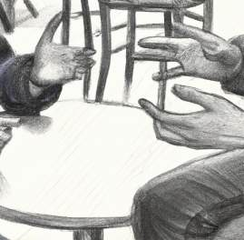
Week 14 — BSL Beginners Level 1
Lesson 14
Final Lesson
Week 14 - Final Recap and Conversations. Present your
topics and/or have a conversation about your topic. Pick a
second subject to chat about in small groups as conversation
practice.
You Can Sign! | British Sign Language Level 1
Slide 211

Slide 212
Week 14 — Skills Checkpoint (Part 1/3)
Mark yourself out of 10 for the following skills to check your progress. The pass mark
for these skills is the ability to use them 50% of the time during a conversation.
Skills Tick OR grade
yourself out of 10
Answered 2-3 questions correctly from another signer.
Sign with consistent flow
Use placement correctly.
Used turn-taking correctly (meaning you have a natural 2 sided
You Can Sign! | British Sign Language Level 1
Slide 212

Slide 213
Week 14 — Skills Checkpoint (Part 2/3)
conversation)
Use non-manual features
Used a range of vocabulary
Expressed time correctly
Express numbers correctly
Finger spelled names of people and places
Used BSL grammar order rather than English
Finger spelled a word back for clarification of 4-6 letters.
Understood other person most of the time
You Can Sign! | British Sign Language Level 1
Slide 213

Slide 214
Week 14 — Skills Checkpoint (Part 3/3)
Use correct hand shape for signs
Expressed emotions and meaning through facial expressions
Use question words correctly
Use sign space correctly
Focus areas
You Can Sign! | British Sign Language Level 1
Slide 214

